Slide 1
PREDICTION OF HEART DISEASES USING ML
17BD1A054D
17BD1A054H
17BD1A055C
17BD1A055K

Slide 2
INTRODUCTION
In todays contemporary world, heart disease is one of the primary reasons for occurrence of most deaths. Heart disease may occur due to unhealthy lifestyle, smoking, alcohol and high intake of fat which may cause hypertension.
According to the WHO more than 10 million die due to Heart diseases every single year around the world. A healthy lifestyle and earliest detection are only ways to prevent the heart related diseases.
This project presents performance analysis of various ML techniques such as Decision Tree and KNN for predicting heart disease at an early stage.

Slide 3
EXISTING SYSTEM
In this system, the input details are obtained from the patient. Then from the user inputs, using ML techniques heart disease is analyzed. Now, the obtained results are compared with the results of existing models within the same domain and found to be improved.
The data of heart disease patients collected from the UCI laboratory is used to discover patterns with NN, Support Vector machines SVM, and Naive Bayes.

Slide 4
DRAWBACKS OF EXISTING SYSTEM
Prediction of cardiovascular disease results is not accurate.
Data mining techniques does not help to provide effective decision making.
Cannot handle enormous datasets for patient records.

Slide 5
PROPOSED SYSTEM
After evaluating the results from the existing methodologies, we have used python operations to perform heart disease classification for the data obtained from the UCI repository. It provides an easy-to-use visual representation of the dataset, working environment and building the predictive analytics.
ML process starts from a preprocessing data phase followed by feature selection based on data cleaning, classification of modelling performance evaluation. KNN technique is used to improve the accuracy of the result.

Slide 6
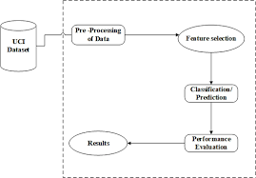
APPROACH
Data Pre-Processing
Feature Selection and Reduction
Classification Modelling
Implementation Models
i. KNN
ii. Decision Trees
5. Performance Measures

Slide 7
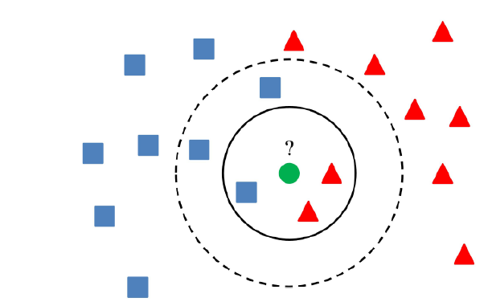
KNN (K-Nearest Neighbours)
It uses Euclidian Distance function dis (xi, xj) to extract the information out of the samples by using the majority vote of the k-nearest neighbours.
Dis(xi,xj) = √(xi,1 – xj,1)^2 + … + (xi,m – xj,m)^2.

Slide 8
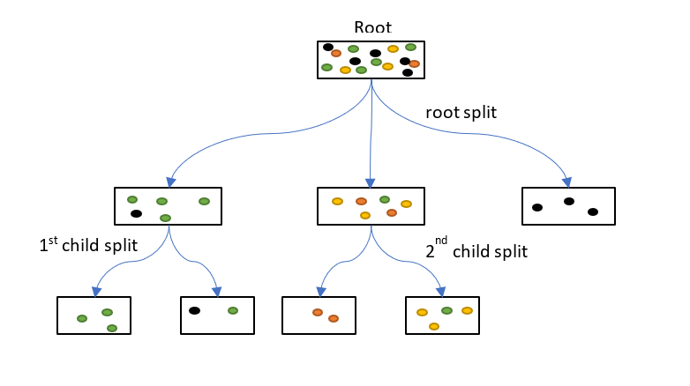
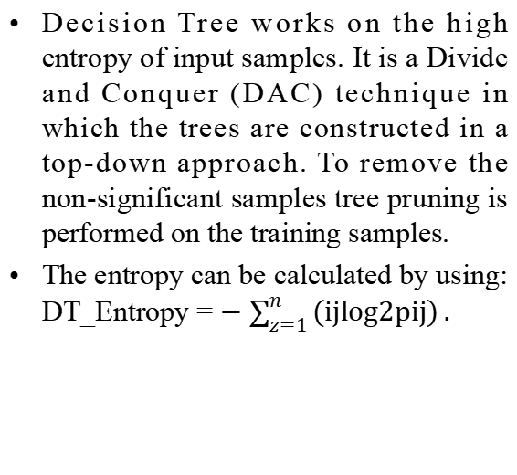
DECISION TREES
Decision Tree works on the high entropy of input samples. It is a Divide and Conquer (DAC) technique in which the trees are constructed in a top-down approach. To remove the non-significant samples tree pruning is performed on the training samples.
The entropy can be calculated by using: DT_Entropy = $−\sum_{z=1}^{n}{\left(ijlog2pij\right)}.$

Slide 9
ADVANTAGES
Increased accuracy for effective heart disease diagnosis.
Handles roughest(enormous) amount of data using KNN algorithm and feature selection.
Reduce the time complexity of doctors.
Cost effective for patients.

Slide 10
SYSTEM REQUIREMENTS
HARDWARE REQUIREMENTS
Processor : Any updated Processor
RAM : Minimum 4GB
Hard Disk: Minimum 100GB
SOFTWARE REQUIREMENTS
Operating System : Windows Family
Technology : Python 3.x
IDE : Jupyter

Slide 11
LITERATURE SURVEY
Jayami Patel et al, suggested heart disease prediction using data mining and machine learning algorithm. The goal of this study is to extract hidden patterns by applying data mining techniques. The best algorithm J48 based on UCI data has the highest accuracy rate compared to LMT.
(Celia et al. 2000) concluded that attribute selection can be performed prior to genetic programming to find a high level of understandable knowledge. Following this study, Hongmei Yan developed a multiplayer perceptron-based decision support system to support the diagnosis of heart disease (Hongmei Yan 2006).
This system is well designed as an input layer of the system with 40 input variables and is categorized into four groups and then encoded using the proposed coding scheme.

Slide 12
DATABASE DESIGN
This database contains 76 attributes, but all published experiments refer to using a subset of 14 of them and 303 instances. In particular, the Cleveland database is the only one that has been used by ML researchers to this date.
The "goal" field refers to the presence of heart disease in the patient. It is integer valued from 0 (no presence) to 4. Experiments with the Cleveland database have concentrated on simply attempting to distinguish presence (values 1,2,3,4) from absence (value 0).
Data Set Characteristics : Multivariate | Number of Instances: 303
Attribute Characteristics: Categorical, Integer, Real | Number of Attributes: 14
Associated Tasks: Classification | Missing Values?: No

Slide 13
ATTRIBUTES
Age: displays the age of the individual.
Sex: displays the gender of the individual using the following format :
1 = male
0 = female
Chest-pain type: displays the type of chest-pain experienced by the individual using the following format :
1 = typical angina
2 = atypical angina
3 = non — anginal pain
4 = asymptotic

Slide 14
Resting Blood Pressure: displays the resting blood pressure value of an individual in mmHg (unit).
Serum Cholestrol: displays the serum cholesterol in mg/dl (unit).
Fasting Blood Sugar: compares the fasting blood sugar value of an individual with 120mg/dl. If fasting blood sugar > 120mg/dl then : 1 (true) else : 0 (false).
Resting ECG : displays resting electrocardiographic results
0 = normal
1 = having ST-T wave abnormality
2 = left ventricular hyperthrophy

Slide 15
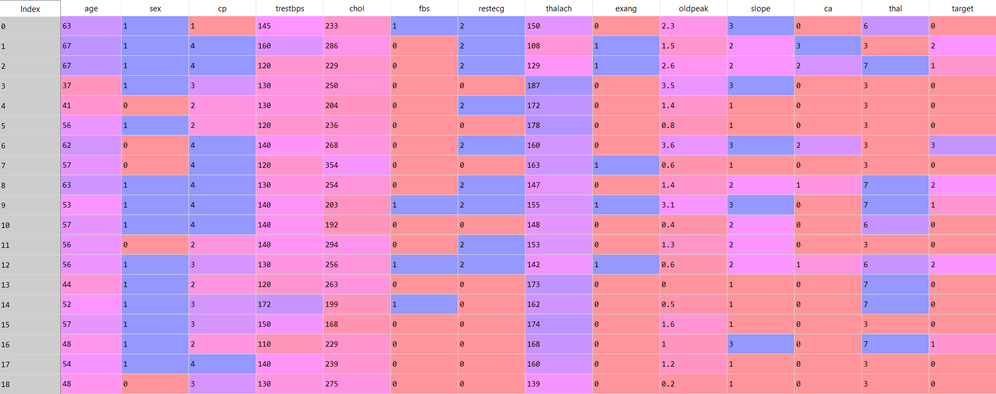
ATTRIBUTES AND INSTANCES OF DATASET

Slide 16
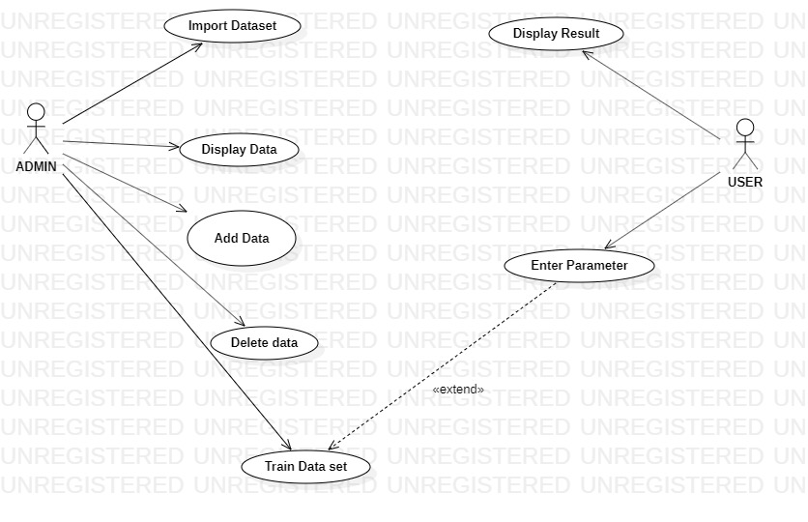
UML DIAGRAMS
USE-CASE DIAGRAM:

Slide 17
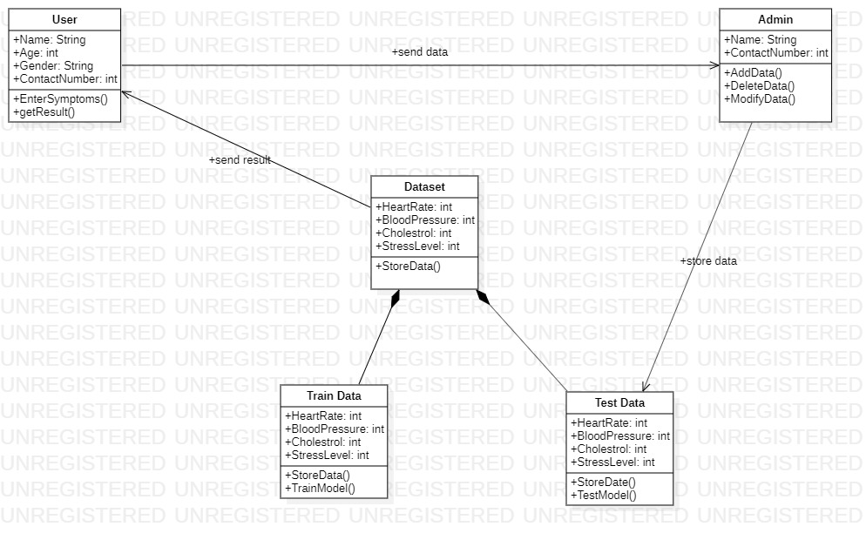
CLASS DIAGRAM:

Slide 18
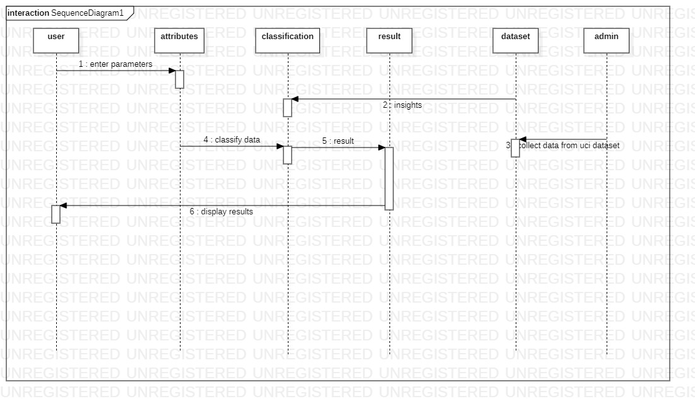
SEQUENCE DIAGRAM:

Slide 19
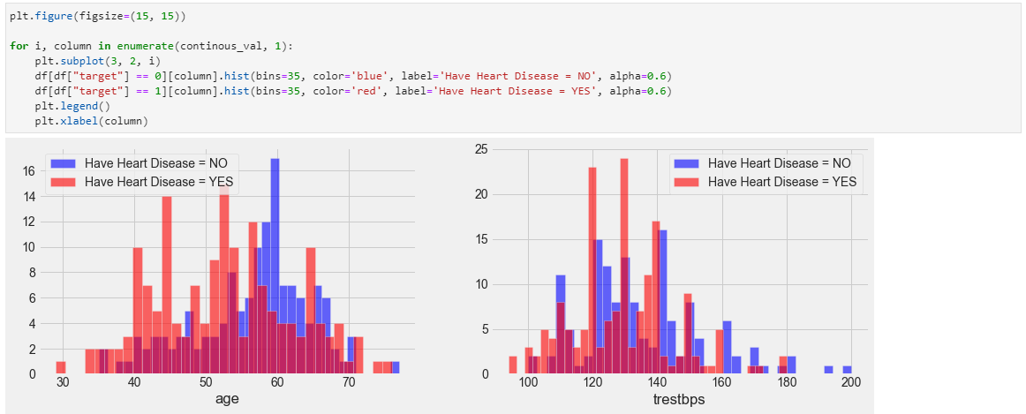
PLOTTING OF ATTRIBUTES

Slide 20
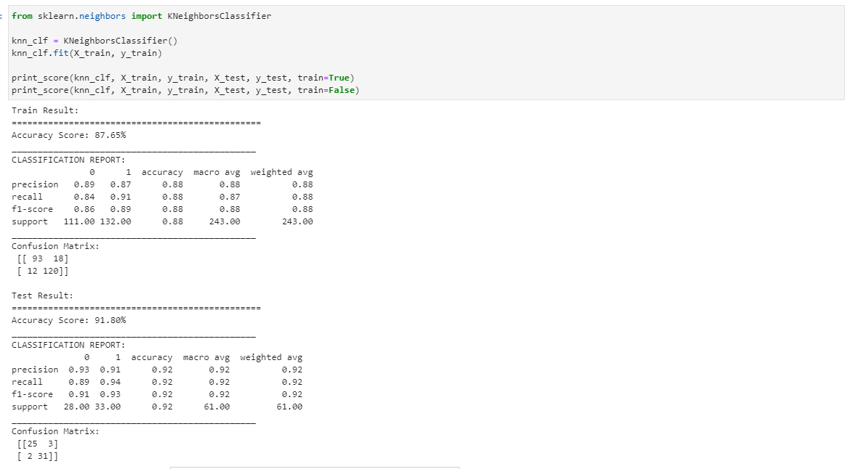
KNN ALGORITHM

Slide 21
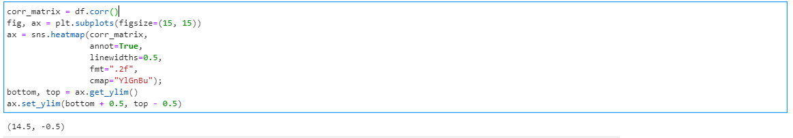
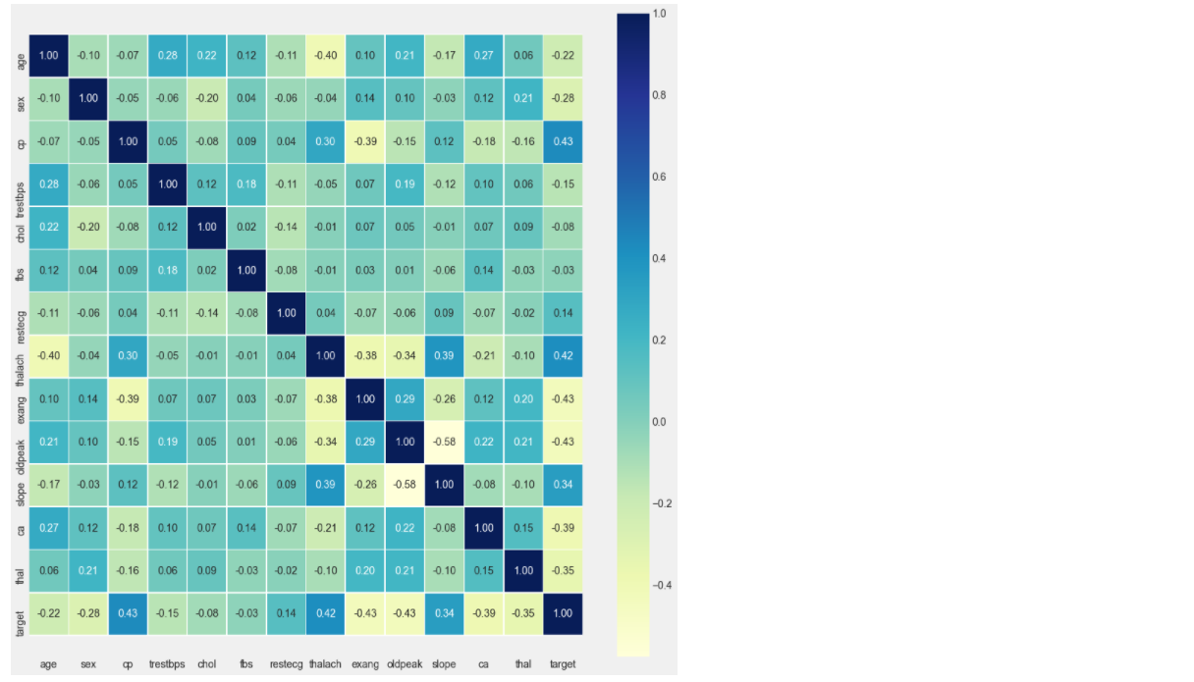
CORRELATION MATRIX

Slide 22
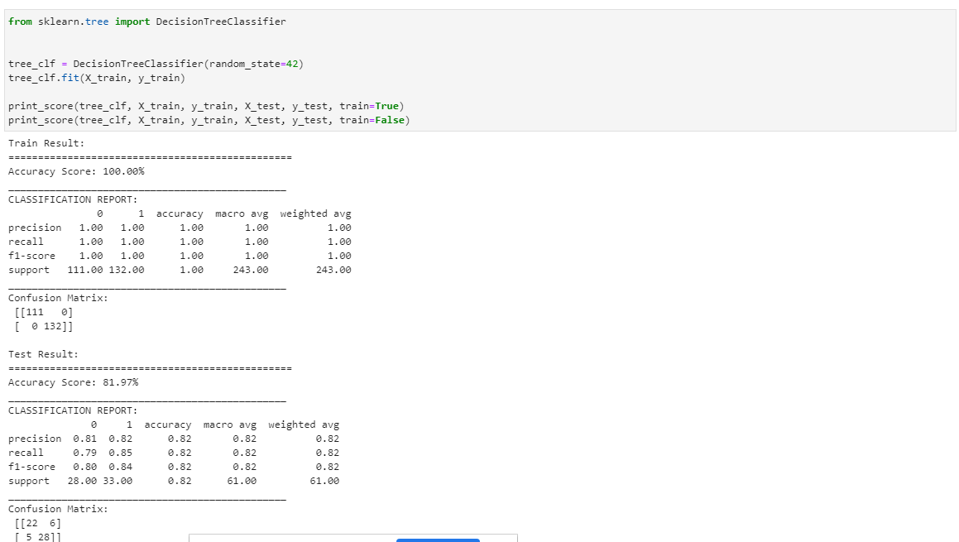
DECISION TREE ALGORITHM

Slide 23
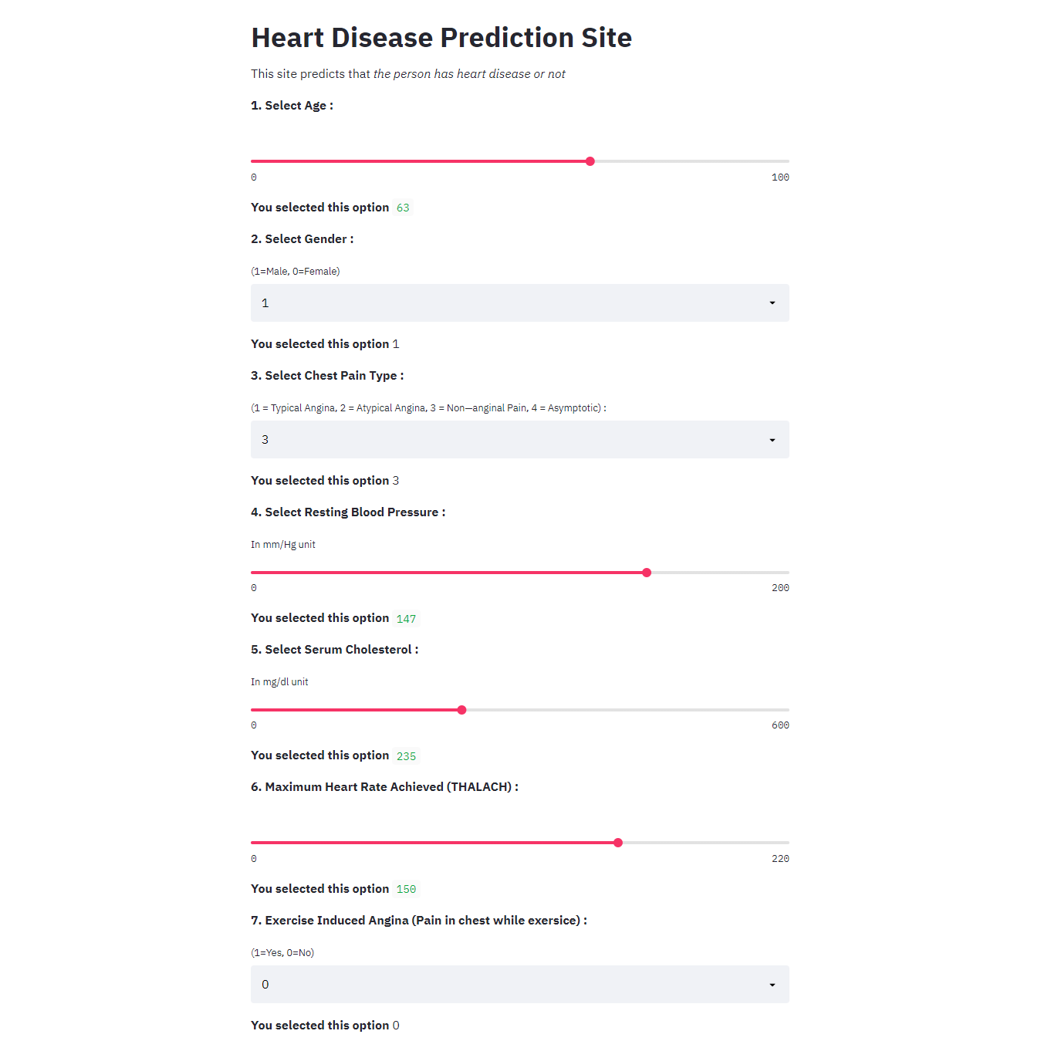
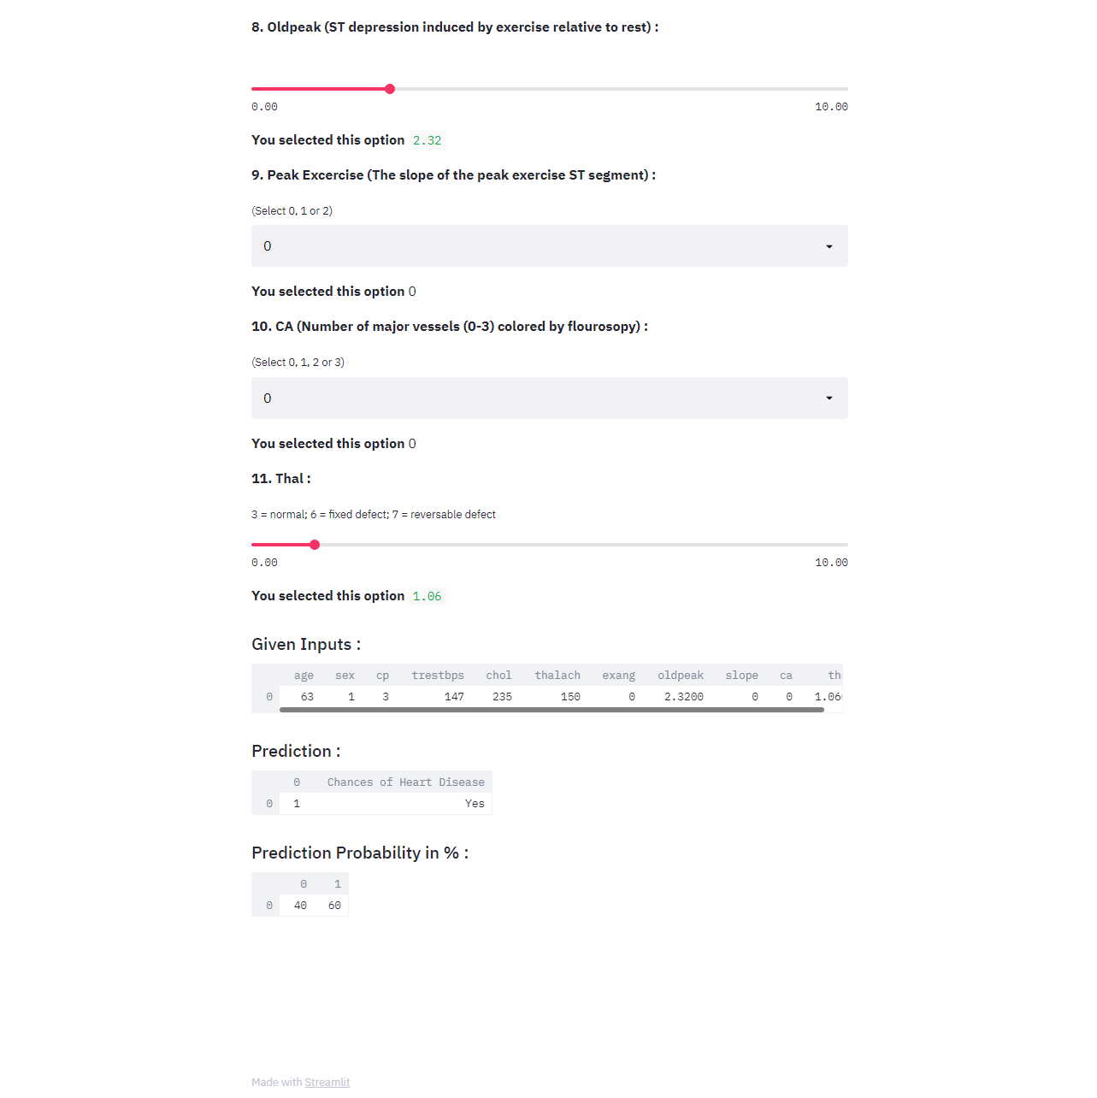
WEBPAGE

Slide 24
CONCLUSION
In this project, we proposed a method for heart disease prediction using machine learning techniques, these results showed a great accuracy standard for producing a better estimation result.
In this what we found is during small datasets in some other cases most of time decision trees direct us to a solution which is not accurate, but when we look at KNN results we are getting more accurate results and random forest results with probabilities of all other possibilities but due to guidance to only one solution decision trees may miss lead.

Slide 25
REFERENCES
https://www.researchgate.net/publication/342210798_Heart_Disease_Prediction_using_Machine_Learning_and_Data_Mining
https://www.irjet.net/archives/V7/i4/IRJET-V7I4993.pdf
https://www.researchgate.net/publication/326733163_Prediction_of_Heart_Disease_Using_Machine_Learning_Algorithms

Slide 26
THANK YOU

